Slide 1
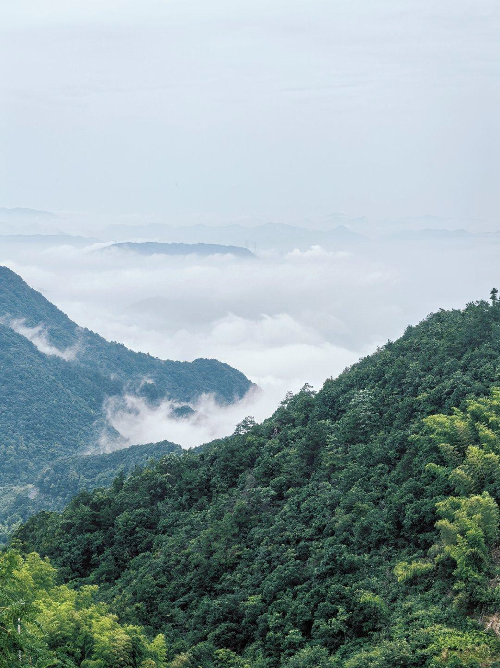
LOOK FOR
/ UNICORNS BOX /
XINMEIJIAN

Slide 2
魔盒物语
【Magic box
Tales】
溪流绕着森林
Crystalline streams braid primordial woods
彩虹背景瀑布声
Cascading thunder framed by spectral rainbows
阳光穿透水幕洗礼着马尔斯绿 Sunlight transmutes torrents into liquid
Mars Green
群群翠色让时间延迟着，杉林淙淙绘出精美作
/
Timeless pines compose sylvan symphonies -
ronicle in rush^{n}inªg^{tu}w^{re}a't^{s}er^{ch}and whispering conifers

Slide 3
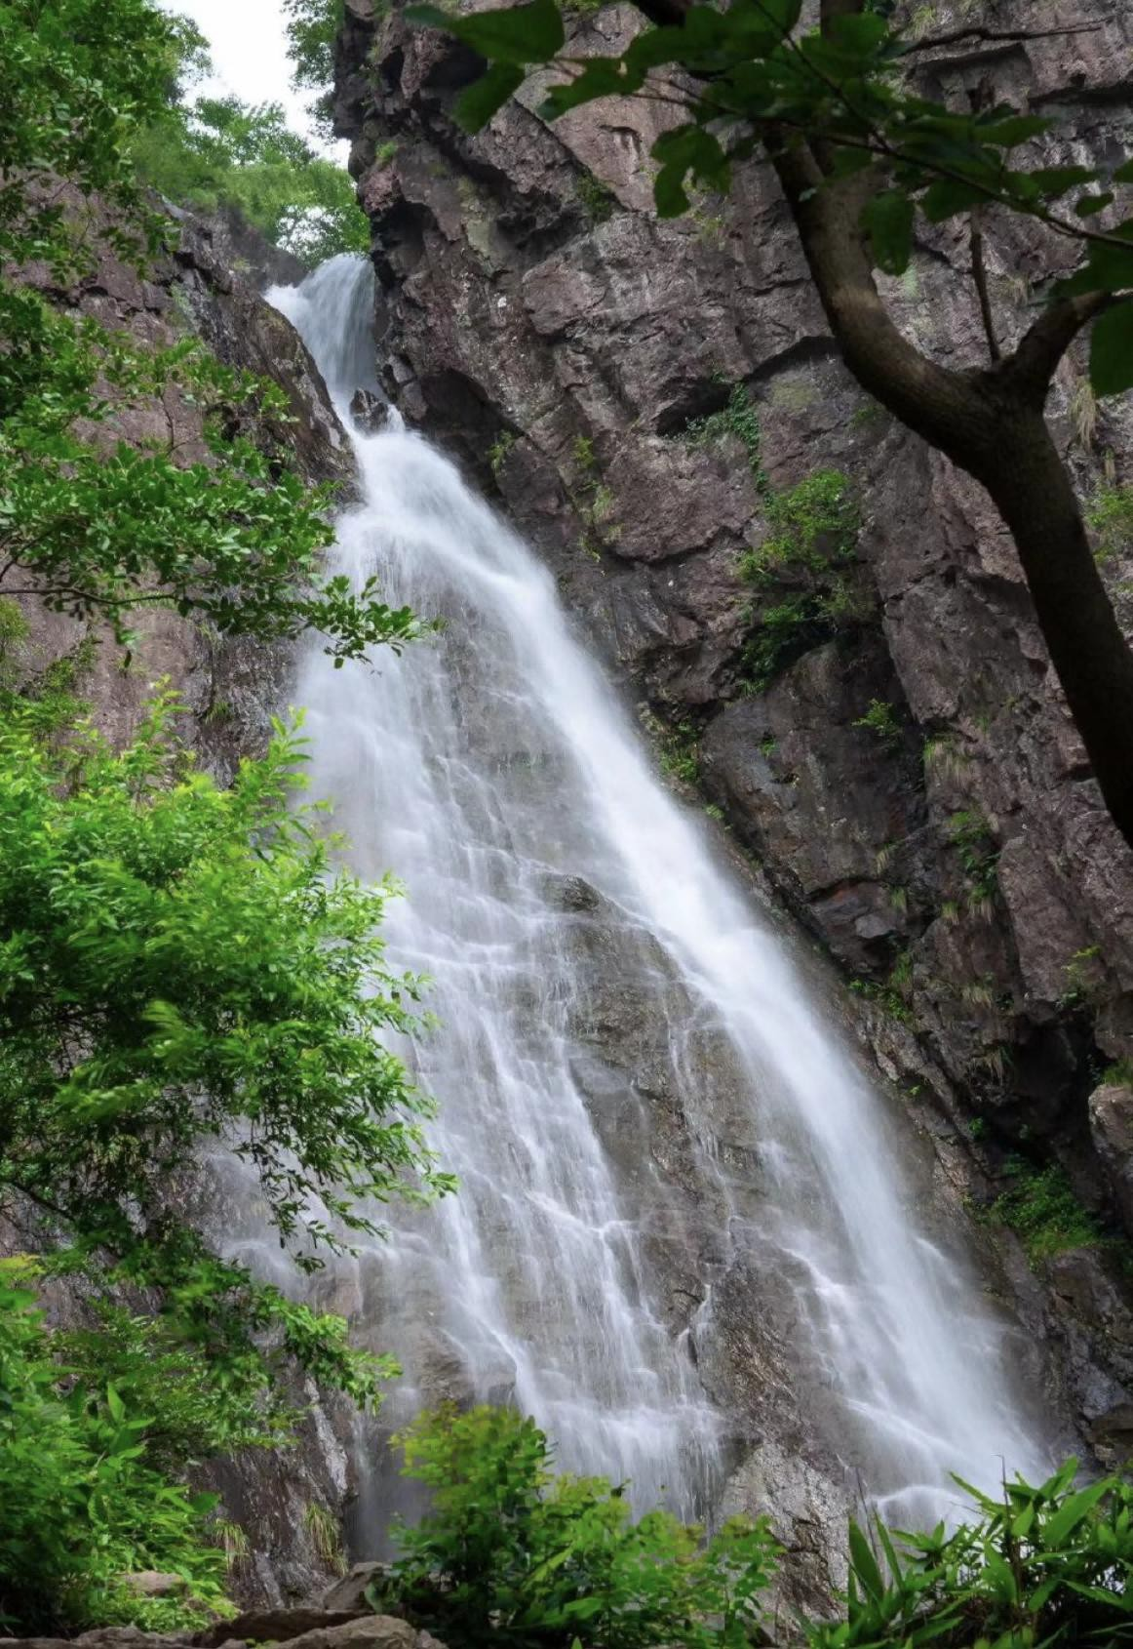

Slide 4
文化亮点
【Key
Highlights】
登顶俯览东方《富春山居图》的雄伟壮观 UNICORNS BOX’s Tales : Where Majesty Meets Mist: Ascend to Panoramic Vistas of Classic Masterpiece "Dwelling in the Fuchun Mountains"
龙门飞瀑秘境徒步：穿越“华东第一瀑”龙门飞瀑，沿溪涧攀行3公里，感受30米高瀑飞泻的雷霆之势。
杏梅尖群山壮阔：登顶富阳最高峰杏梅尖
（海拔1067米），
俯瞰群山威势与云海共舞，徒步 合计12公里中难度环线，累计爬升 1000米。龙门古镇烟火漫游：
探访权故里，青石板街寻三国遗韵，尝非遗油面筋。
（雾水中）
（神现彩）
（虹秘境）

Slide 5
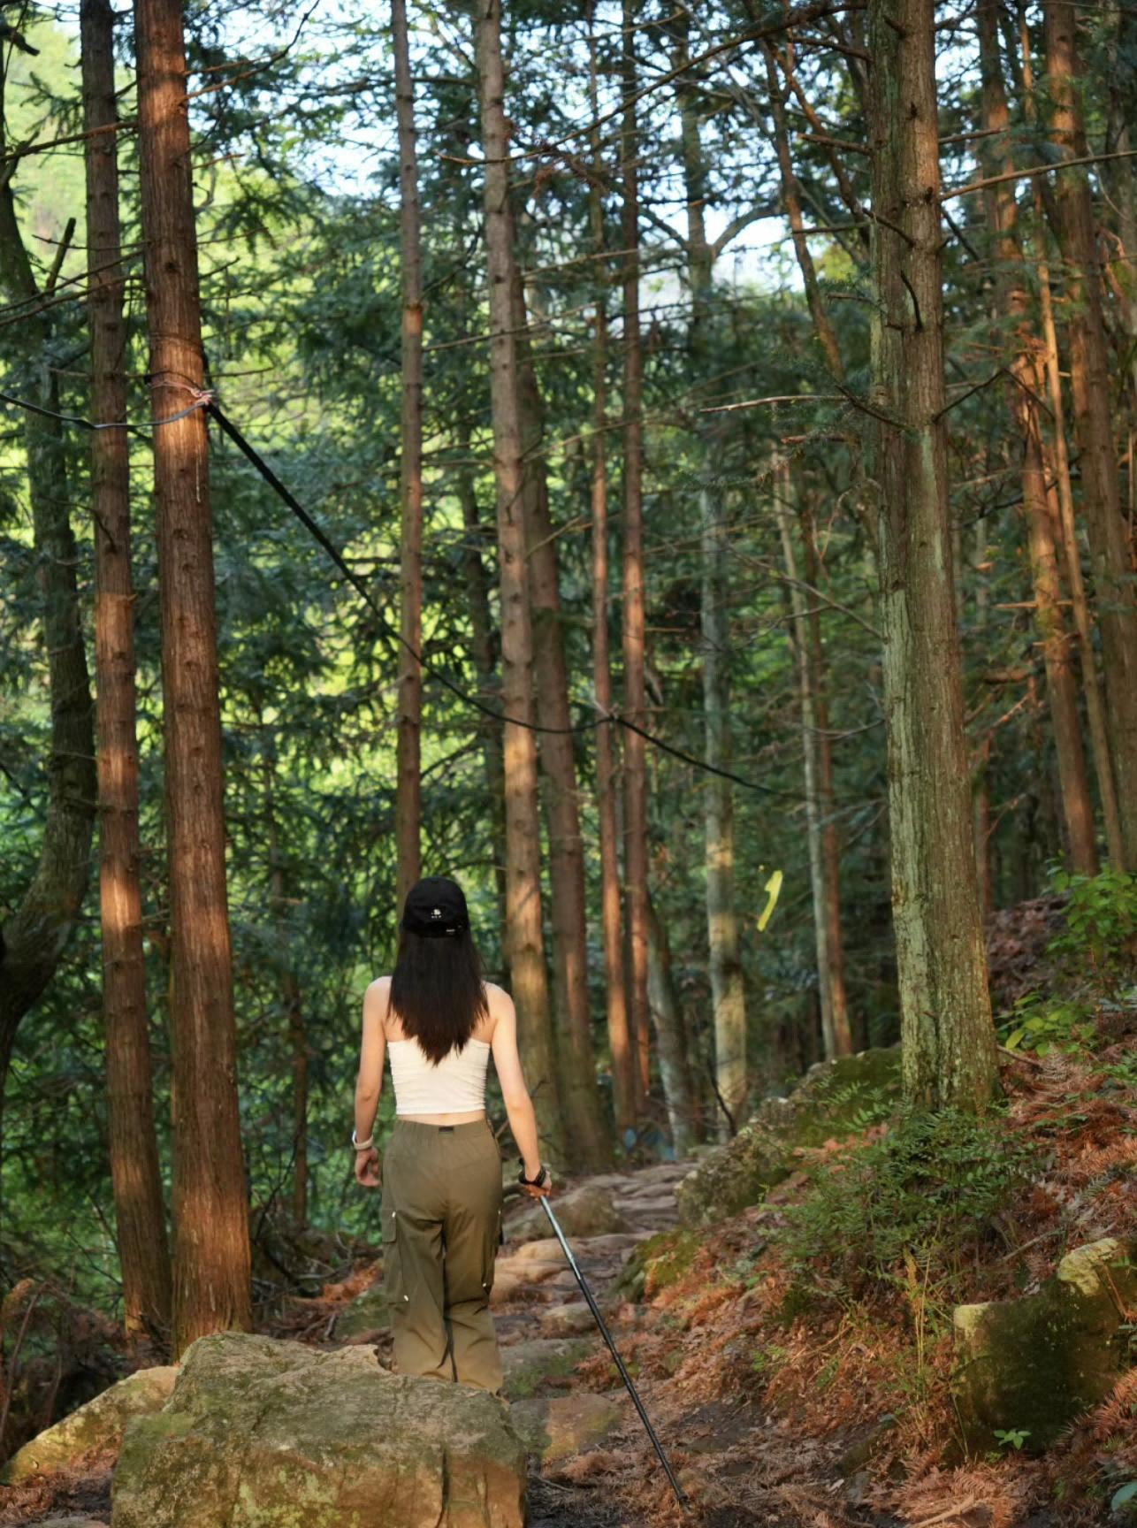
SLACK
Longmen Flying Waterfall Secret Realm Hiking: Crossing the 'First Waterfall in East China'
Longmen Waterfall, climb along the stream for 3 kilometers and feel 30 meters The thunderous force of the cascading waterfall.
Apricot and Plum Peaks, majestic mountains: Climbing to the highest peak in Fuyang, Apricot and Plum Peaks
(altitude 1067 meters),
Overlooking the majestic mountains and dancing with the sea of clouds, hiking Total 12 kilometers of medium difficulty loop, cumulative climb 1000 meters. Fireworks Roaming in Longmen Ancient Town:
Exploring the Hometown of the Right to Visit, Searching for Three on Qingshan Street National heritage charm, tasting intangible cultural heritage oil gluten.
(In foggy water) (Shining Colors) (Rainbow Secret Realm)

Slide 6
【独角兽的魔盒】 WE: UNICORNS BOX
我们将为各位热爱户外朋友们精心设计户外精途魔法线，不断推出盲盒惊喜单元，双语环境，中外友谊并肩同行，专业及安全服务相伴，独角兽携手大家一起守护正能量与纯洁。
WE:
We craft magical outdoor adventure routes for nature enthusiasts, blending "blind box-inspired surprises" into every journey. Embrace bilingual exploration, cross-cultural camaraderie, and professional support for safety and joy. Join Unicorn in safeguarding nature’s
purity and sharing positive energy!

Slide 7
【程与诚】
Itinerary: Journey of Sincerity
06:50 世纪大道、宜山路集合出发
6:50AM Depart from Century Avenue & Yishan Road 10:30 抵达龙门飞瀑，开启瀑布溯溪徒步
10:30AM Arrive at Longmen Waterfall, embark on our streamside hike through cascading wonders
13:30 登顶杏梅尖，享受山巅盛景
1:30PM Conquer Xingmei Peak’s summit, savor breathtaking panoramic mountainscapes.
18:00返程上海
18: 00PM Return to Shanghai
【加入魔盒】
[Join Us]
线路全长：13KM，累计爬升约960m
Total length of the route: 13km, with an elevation gain of approximately 960m
预计时长：6H Estimated duration: 6H难度：中等难度 Difficulty level: Medium风景度：五颗星
Scenic rating: Five Stars
难度：入门 风景度：四颗星
盲盒名额：免费与折扣 盲盒礼：周边礼品
Difficulty: Beginner Scenery: Four Star Blind Box
Quota: Free and Discounted Blind Box Gift: Peripheral Gifts

Slide 8
【费用信息】[Cost Information]
交通：舒适豪旅大巴，司机路桥燃油停车等费用物资：配备应急医疗物资
服务：全程双语领队，活动策划组织费用，人身保障：户外高额30w保险
Transportation: Comfortable luxury bus, driver's road and bridge fuel parking fees, etc
Material: Equip with emergency medical supplies Service: Full bilingual team leader, activity planning and organization fees,Personal protection: Outdoor high-value 300000 yuan insurance
【注】[Note]
行程通知：最晚在出行前1天给您发送，如未收到请联系
工作人员。集合时间、地点、服务人员等信息以《行程通知》为准。预定限制：请有心脑血管疾病、心脏病史、孕妇及其余身体不
便的人士避免参加户外徒步活动，请8～55岁之外的老人及未成年人在有监护人员的情况下参与，并将同行情况
提前报备。
活动装备：本次活动为轻装徒步，建议携带登山杖、防滑鞋等基础装备。需带宠物提前讲，并支付50元清洁费。
Travel notification: We will send it to you no later than 1 day before departure. If you have not received it, please contact our staff. The gathering time, location, service personnel and other information shall be subject to the "Travel Notice".
Reservation restrictions: Individuals with cardiovascular and cerebrovascular diseases, a history of heart disease, pregnant women, and others with physical disabilities are advised to avoid participating in outdoor hiking activities. Elderly and minors aged 8-55 are required to participate with a guardian and report their travel status in advance.
Event equipment: This event is a light hiking, and it is r ecommended to bring basic equipment such as hiking poles and anti slip shoesPets must be brought in advance and
a cleaning fee of 50 yuan must be paid

Slide 9
魔盒爱心
UNICORNS BOX’s LOVE
保护户外生态环境，请大家敬畏自然，不轻狂。让我们携手共创美好爱心box文明团，共勉之！
To protect the outdoor ecological environment, please respect nature and not be reckless. Let's work together to create a lovely and caring UNICORNS BOX Team, and encourage each other!

Slide 10

Unicorns BOX
Art NOUVEAU
独角兽的魔盒
/
新艺术运动
your kingdom
你 的 王 国

